Slide 1
Avoiding the UK IoT Disaster
Edward Nutting, Founder of FlingOS

Slide 2
Internet of Things
What do we mean?
Small, embedded devices
(Probably) Wireless connection
To central data stores
Everything from the long-awaited affordable smart-home,
To better managed lamp posts and traffic lights

Slide 3
Is IoT just a fad?
No
It is looking like the “next web”
Explosion in interest, companies (big and small) and research
Bristol Is Open
University of Bristol research : New smart internet lab launched this week
Many start-ups in the Bristol area

Slide 4
What does IoT require?
Research, hardware, connectivity, etc…
But also software!

Slide 5
What kind of software?
Low-level
Specialist per device
Low-bloat / minimum built-in
Highly efficient use of resources
Reduces hardware requirements to a minimum
Thus reducing cost + increasing battery life
Devices need to be designed to last a long time
But a lot of current devices follow the standard equipment cycle : 2 years life
But common functionality (e.g. Wi-Fi connectivity) can be shared across codebases : Package management, libraries, ways to only include required parts of libraries

Slide 6
But…
Low level isn’t being taught!

Slide 7
Universities
Little OS and low-level teaching in many Universities
Some low-level dev done but little to no understanding as to why it’s different
University of Bristol:
1st Year : Computer Architecture : Some OS teaching in 2nd term (Prof. David May)
2nd Year : Concurrency : Use of XMOS/XC for a project, Further OS teaching, does not include low-level things like drivers
3rd Year : Optional modules in High-Performance Computing, AI with Logic Programming
4th Year : Optional modules in Advanced Computer Architecture, Interactive Devices, Robotic Systems
Modules do not tie OS / low-level into the rest of the course
Optional means a significant proportion won’t be taking the module
University of Bristol is better than most!

Slide 8
Under the new CS National Curriculum and existing A-level, the concept of an OS is introduced at which key stage?
By show of hands…
Key Stage 1 (Years 1 to 2 : Up to age 7)
Key Stage 2 (Years 3 to 6 : Up to age 11)
Key Stage 3 (Years 7 to 9 : Up to age 14)
Key Stage 4 (GCSEs : Up to age 16)
A-level : Up to age 18

Slide 9
Never

Slide 10
Only “low-level” content is…
Extract from https://www.gov.uk/government/publications/national-curriculum-in-england-computing-programmes-of-study/national-curriculum-in-england-computing-programmes-of-study
KS3 (Years 7 to 9, up to age 14):
understand simple Boolean logic [for example, AND, OR and NOT] and some of its uses in circuits and programming; understand how numbers can be represented in binary, and be able to carry out simple operations on binary numbers [for example, binary addition, and conversion between binary and decimal]
understand the hardware and software components that make up computer systems, and how they communicate with one another and with other systems
understand how instructions are stored and executed within a computer system; understand how data of various types (including text, sounds and pictures) can be represented and manipulated digitally, in the form of binary digits

Slide 11
Even the BBC Microbit won’t change this…
...because it’s programmed in Blockly (equivalent to Scratch) and Python
And it’s very difficult to hack outside of the provided tools

Slide 12
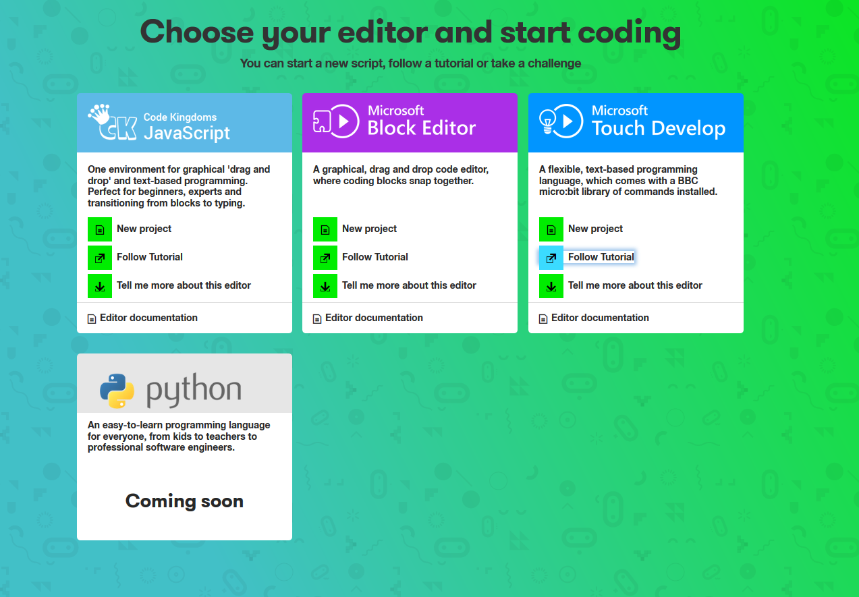
Microbit
Screenshot of https://www.microbit.co.uk/create-code taken by Edward Nutting, 03-12-2015

Slide 13
Schools will be teaching…
In Scratch/Blockly, Python, Java, C#, others?
But not C or C++
Using RapsberryPi’s, BBC Microbits – arguably large but embedded devices
Often used for IoT / Robotics style projects
Good for learning, but:
You still need to point out that there are better implementations
You still need to teach proper low level at some point
Neither of these are currently done nor will be done
Gives the impression that Linux + Python is OK for IoT
But fundamentally it isn’t.

Slide 14
So what are the issues here?
Low-level isn’t taught to enough extent
My peers are supposed to have studied some of it but still can’t explain the bits they have studied (despite good grades)
And they won’t be required to-cover the material again
So they will be able to graduate (potentially with 1st class honours) without understanding OS or low level software
High-level is heavily taught
Creating a generation of high-level developers
Who don’t understand how an OS or driver works nor what they are for
This leads to misuse and poorly targeted software
And significant security flaws

Slide 15
And there’s one extra issue…
Past approaches to teaching low-level are no longer appropriate
Previously:
Little to no prior knowledge
Computers were much less powerful, so most people had only experienced low-level style computing (original BBC Micro, DOS, even programs on early Windows NT)
Now:
Generation about to hit A-level/Universities with lots of high level knowledge (used to tablets/laptops)
It’s actually harder to transition from high level language (e.g. C#) to low level (e.g. C) than starting from scratch!
But that’s how it’s taught at the moment
Need to make use of student’s knowledge as they enter University – work with their knowledge
Need to be able to teach C and OS/low-level dev alongside each other, not C then OS/low-level

Slide 16
So what’s the potential disaster?
UK Industry is well positioned but,
The UK will not have graduates with the right knowledge
Meaning our industry is going to struggle
Potentially very high cost of training new employees
But also, start-ups (generally small teams of bright young students/graduates) are at high risk of using inappropriate technology without realising

Slide 17
So how do we avoid disaster?
Teach low level and OS dev of course!
In both schools and Universities
But in a new way…

Slide 18
FlingOS: An educational OS
FlingOS is an educational operating system
Codebase, articles and videos
Totally new approach: Our OS is in C#
This is not a commercial OS
But C# is a great way to use high-level knowledge to understand low-level
Allows teaching of C alongside OS’es
This makes understanding both a lot easier

Slide 19
FlingOS: Does it work?
Yes!
The online community has given us fantastic responses and encouragement
Working with and supported by the University of Bristol
Students have said they find our content easier to understand
Total of over 8,500 views per month of our content and growing

Slide 20
FlingOS: What’s next for us?
Working with the University of Bristol
We want to expand our resources:
Code: Networking, OS-dev starter-kit for A-level/1st Year University
Articles: 50 more
Tutorial videos: 15 more
How? Summer interns 2016
Looking for sponsorship or support
Head to www.flingos.co.uk/sponsor

Slide 21
Thank you
Edward Nutting, Founder of FlingOS
www.flingos.co.uk
contact@flingos.co.uk

Slide 22
Any questions?

